Slide 1
Trilateral collaboration Nov 2019

Slide 2
Overview
Current projects
Florence: IgE / Asthma in whole blood MCC-seq.
Catherine: SLSJ in fractionated blood / whole blood MCC-seq.
Pierre: T1D in whole blood WGBS / GH response in blood MCC-seq.
Interim analyses/Tomi; Progress with new samples/Alfredo+Tony
Reiner/Ezio: small cell # assays?
Collaborative opportunities
4DN Nucleome
Infectious disease/T1D etiology epigenomics
Extreme methylation variation (WGBS)
mQTL meta-analyses and disease colocalization

Slide 3
Interim approach to GH and T1D data
GH: “standard” immune-panel MCC-seq. (~20x)
Apply linear model for >5x coverage: t0 vs. t1 (49 pairs)
Use cell loadings (from methylation reference) as covariate (no other covariates)
Explore relative hypo/hypermethylation against gene networks (GREAT, DAVID, Metascape)
T1D: comprehensive whole genome bisulphite seq. (~20x)
Apply linear model for >5x coverage: t0 vs. t1 (69 pairs)
Use cell loadings (from methylation reference) as covariate (no other covariates)
Explore relative hypo/hypermethylation against gene networks (GREAT, DAVID, Metascape)

Slide 4
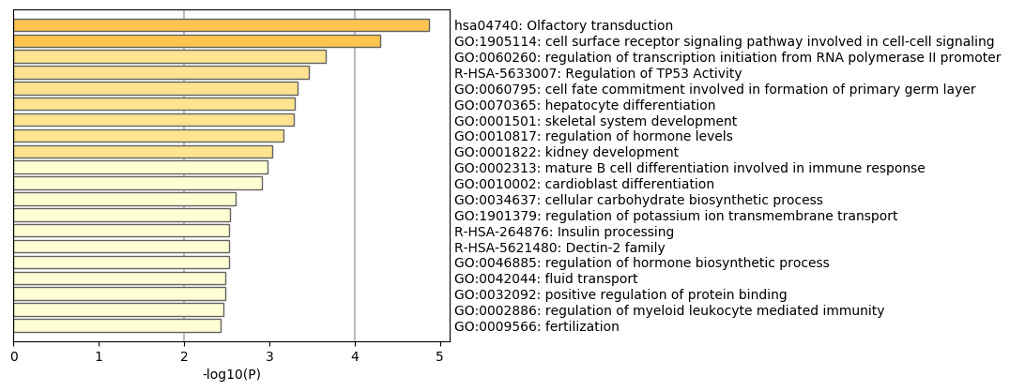
T1D t0 vs. t1 hypomethylation
~3600 CpGs @ P <0.001
Majority (~90%) signals distal to TSS (>10kb)
Interesting Enrichment in MetaScape Enriched Ontology Clusters
HNF1B
Diabetes mellitus, noninsulin-dependent,

Slide 5
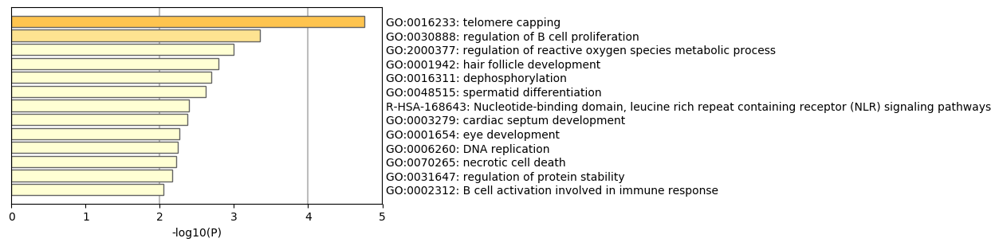
T1D t0 vs. t1 hypermethylation
~1262 CpGs @ P <0.001
Majority (~85%) signals distal to TSS (>10kb)
No clear link to expected biology

Slide 6
Metabolic disease links in T1D hypermCGs?
Category Term Count % P-Value Benjamini
GAD_DISEASE Cholesterol, HDL 12 8.5 7.6E-4 4.5E-1
GAD_DISEASE breast cancer 11 7.8 9.2E-3 9.7E-1
GAD_DISEASE susceptibility to MS 2 1.4 1.6E-2 9.8E-1
GAD_DISEASE benzene haematotoxicity 7 5.0 2.0E-2 9.8E-1
GAD_DISEASE longevity 9 6.4 2.2E-2 9.7E-1
GAD_DISEASE Hodgkin Disease 5 3.5 2.3E-2 9.5E-1
GAD_DISEASE Joubert sdr nephronophthisis 2 1.4 2.4E-2 9.3E-1
GAD_DISEASE Myocardial Infarction 10 7.1 3.0E-2 9.5E-1
GAD_DISEASE Parkinson Disease 6 4.3 3.0E-2 9.3E-1
GAD_DISEASE aspergillosis 2 1.4 3.2E-2 9.2E-1
GAD_DISEASE Candidiasis, Oral|HIV| 2 1.4 4.0E-2 9.4E-1
GAD_DISEASE Body Fat Distribution 4 2.8 5.1E-2 9.7E-1
GAD_DISEASE Chronic renal failure 13 9.2 6.2E-2 9.8E-1
GAD_DISEASE Triglycerides 8 5.7 6.4E-2 9.7E-1
GAD_DISEASE esophageal adenocarcinoma 7 5.0 6.5E-2 9.6E-1
GAD_DISEASE Pancreatic Neoplasms 5 3.5 6.7E-2 9.6E-1
GAD_DISEASE Lymphocytosis 2 1.4 7.1E-2 9.6E-1
GAD_DISEASE myocardial infarct 4 2.8 7.5E-2 9.6E-1
GAD_DISEASE Blood Pressure 8 5.7 8.1E-2 9.6E-1

Slide 7
GH – treatment induced hypomethylation n=1261 (Gene ontology enrichment, GREAT)
Notes:
This visualization generates a directed acyclic graph (DAG) based on the enriched terms from a single ontology-specific table from a GREAT job. Enriched terms are shown in blue. Nodes have been sized according to Binomial Fold Enrichment.
10kb

Slide 8
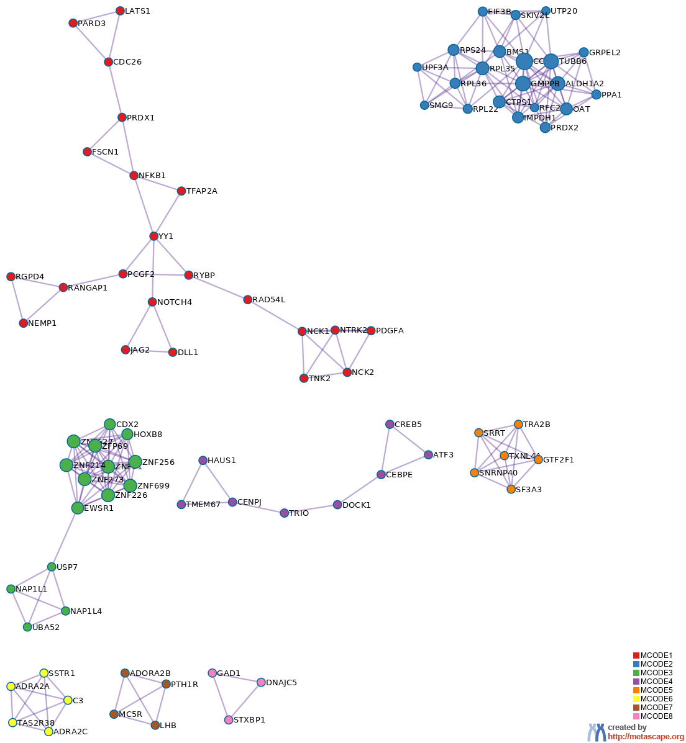
Ppi networks in GH Tx hypomethylation (Metascape)
Input ID_SUB1_MCODE_1 | M17|PID NOTCH PATHWAY|-6.6;R-HSA-186763|Downstream signal transduction|-5.6;GO:0033135|regulation of peptidyl-serine phosphorylation|-5.1
Input ID_SUB1_MCODE_2 | GO:0000184|nuclear-transcribed mRNA catabolic process, nonsense-mediated decay|-11.2;GO:0000956|nuclear-transcribed mRNA catabolic process|-9.5;R-HSA-975957|Nonsense Mediated Decay (NMD) enhanced by the Exon Junction Complex (EJC)|-9.3
Input ID_SUB1_MCODE_3 | GO:0065004|protein-DNA complex assembly|-3.4;GO:0071824|protein-DNA complex subunit organization|-3.2;GO:0071103|DNA conformation change|-3.0
Input ID_SUB1_MCODE_4 | GO:0097711|ciliary basal body-plasma membrane docking|-5.5;R-HSA-5620912|Anchoring of the basal body to the plasma membrane|-5.4;GO:0007098|centrosome cycle|-5.1
Input ID_SUB1_MCODE_5 | R-HSA-72163|mRNA Splicing - Major Pathway|-12.8;R-HSA-72172|mRNA Splicing|-12.6;R-HSA-72203|Processing of Capped Intron-Containing Pre-mRNA|-12.0
Input ID_SUB3_MCODE_6 | R-HSA-418594|G alpha (i) signalling events|-8.9;R-HSA-500792|GPCR ligand binding|-8.6;R-HSA-373076|Class A/1 (Rhodopsin-like receptors)|-6.8
Input ID_SUB2_MCODE_7 | hsa04080|Neuroactive ligand-receptor interaction|-7.8;R-HSA-500792|GPCR ligand binding|-6.9;R-HSA-418555|G alpha (s) signalling events|-6.6
Input ID_SUB1_MCODE_8 | R-HSA-888590|GABA synthesis, release, reuptake and degradation|-9.4;R-HSA-112310|Neurotransmitter release cycle|-8.1;GO:0007269|neurotransmitter secretion|-6.5

Slide 9
Developmental disease genes in GH hypomethylation (DAVID)
ATIC | CENPJ | MAP2K2
OGG1 | C3orf58 | MVB12B
ALX4 | COL11A2 | NACA2
BARX1 | CNTN5 | NPR3
ELF5 | CRELD1 | NTRK2
FAM20A | CRLF1 | NFKB1
ISL1 | DLL1 | PAX6
KLF6 | ENG | PITX2
NKX2-1 | FAM208A | KCNJ12
RYBP | FSCN1 | RFC2
RND3 | FGF2 | RYR2
SATB2 | FRS2 | SORCS2
SMURF1 | FZD8 | SUGCT
TBX3 | GAD1 | SVEP1
TBX4 | HAND2 | TACR1
WNT2 | HOXD10 | TSHZ3
ZIC2 | IRF9 | TSPAN2
ATF3 | JAG2 | TFAP2A
ADA | LEF1 | TGFB2
ALDH1A2 | HLA-B | TMEM67
ARNT2 | MME | VAX1
CRABP2 | MAPKAP1 | ZNF212

Slide 10
GH treatment induced hypermethylation n=1073 (Gene ontology enrichment, GREAT)

Slide 11
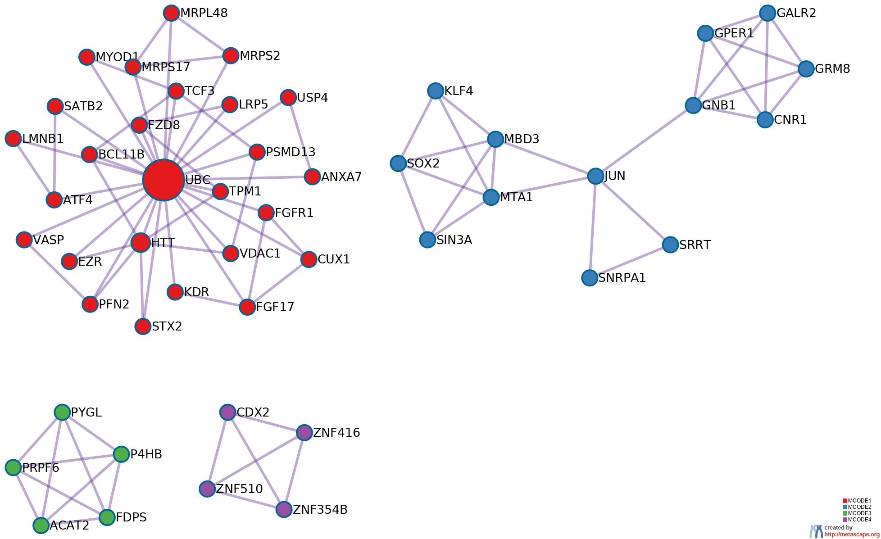
Ppi networks in GH Tx hypermethylation
Input ID_SUB1_MCODE_1 | R-HSA-5663202|Diseases of signal transduction|-6.9;R-HSA-4641263|Regulation of FZD by ubiquitination|-5.8;hsa04015|Rap1 signaling pathway|-5.6
Input ID_SUB1_MCODE_2 | GO:0007188|adenylate cyclase-modulating G protein-coupled receptor signaling pathway|-7.1;GO:0007187|G protein-coupled receptor signaling pathway, coupled to cyclic nucleotide second messenger|-6.8;R-HSA-418594|G alpha (i) signalling events|-5.8

Slide 12
Numerous disease genes in GH hypermethylation (DAVID)
IMMUNE PTGES3, HRNR, ACVRL1, B3GALT4, NELL1, FGFRL1, TBX20, PIP5K1B, DUOX1, FSTL4, JAG1, DLK1, MMP2, GP6, FLI1, C18ORF25, GATA6, ATF6B, RHOA, TNIP2, YDJC, EGR1, SATB2, KIDINS220, NRIP1, IFNAR1, PTHLH, CYP27A1, GNB1, GRM8, JUN, NEU1, VGLL4, SCAF8, CUX1, MGAT5, MFNG, LMNB1, USP4, SOX2, EGLN3, CTNND2, CDH1, PRRC1, AHSG, N4BP2, EZR, ABHD16A, KIRREL, COL6A5, XBP1, STX17, CNR1, TNFRSF18, STK38L, GAD1, PEX10, NKX2-3, GLT1D1, PHACTR2, CARD9, ZBTB46, SLC12A2, MSH5, TNFRSF13B, EN1, HBA1, KLK1, SPARC, DOCK3, RGS14, KDR, VDAC1, PPP1R9A, COL19A1, PYGL, DIO3, CSGALNACT2, NEUROD1, KCTD15, CYP2R1, TCF19, ZNF385B, IRF4, OGG1, ZFHX3, HDAC7, LRP5, DMBT1
DEVELOPMENTAL AMZ1, ADAMTS17, FGFR1, LTBP2, ZNF510, MME, DEFB129, CDH1, ATP5G2, JAG1, HOXD1, PTMA, MMP2, AHSG, ZIC2, BARX1, HOXA2, SIN3A, FLI1, HAND2, GATA6, COL6A5, HOXA5, CHRNA4, HOXA9, GAD1, PEX10, OCA2, BMP3, FZD8, TMPRSS2, SATB2, TNFRSF13B, TBX1, VAX2, MSC, DOCK3, ASCL2, HIPK3, DLX5, NTRK2, TFAP2A, FAM155A, ZNF385B, IRF4, OGG1, CUX1, NCOR2 310 1502 12971 1.337159056741549 0.42479843489944213 0.2415795591490444 20.26605799935358 GAD_DISEASE_CLASS PSYCH 60 13.303769401330376 0.03576998301461759 FIGNL1, WFS1, TBX20, PIP5K1B, FSTL4, CNP, JAG1, NR2E1, FOXO6, GALR2, CHRNA4, GRID1, EGR1, RAX, EGR4, SPTLC3, CNTNAP5, OTX1, POM121L2, IFNAR1, PTHLH, GRM8, HIPK3, TFAP2A, PLA2G6, VGLL4, SCAF8, ADAMTS2, PREP, CPLX3, FGFR1, USP4, CTNND2, MME, ACAT2, SYPL2, XBP1, CNR1, PER1, GAD1, ZNF804A, SLC12A2, HTT, TBX1, EN1, KCTD2, LMX1A, DOCK3, KCNK3, ATF4, EPHA6, SLC6A5, NTRK2, MBOAT1, FAM155A, NEUROD1, KCTD15, ZNF385B, LRP2, NCOR2
VISION PTGES3, EGR1, ADAMTS17, RAX, LTBP2, FSCN2, MSH5, SOX2, MITF, CTNND2, MTA1, CDH1, DLK1, SPARC, MMP2, COL5A1, KDR, CARD10, NAPEPLD, GNB1, CHRNA4, IRF4, OGG1, OCA2, LRP5
METABOLIC MYOD1, CDX2, LTBP2, PRC1, WFS1, LTBP3, B3GALT4, NELL1, TDRP, PKMYT1, FSTL4, JAG1, DLK1, HOXD1, MMP2, FLI1, GATA6, SLC2A2, CHRNA4, SAP30L, GRID1, R3HCC1, SPTLC3, C16ORF62, UBE2J2, ARID1B, TBR1, PTHLH, ADAMTS6, WFDC9, JUN, VGLL4, MRPL48, MGAT5, FGFR1, EFCAB8, PRLHR, ADAMTSL2, SOX2, MAP4K2, PRRC1, ACAT2, NAA35, AHSG, METTL22, HOXA2, HOXA5, CNR1, HOXA9, STRBP, LIPT2, GAD1, BMP3, PHACTR2, TNFRSF13B, FDPS, EN1, HBA1, LHPP, KCNK3, KDR, ATF4, EPHA6, DIO3, DLX5, NTRK2, KCTD15, CYP2R1, ZNF385B, WDR1, BEGAIN, UTP20, ZFHX3, CLEC14A, KLF4, NCOR2, CYB5R2, SEPHS1, ACVRL1, TBX20, MITF, DUOX1, NAP1L5, KISS1R, P4HA3, RHOA, FOXB2, PDE8A, PIEZO2, OCA2, CYR61, EGR1, VSIG10, ZCCHC2, REV1, CNTNAP5, ARHGEF12, ARRDC3, LDLRAP1, IFNAR1, NRIP1, KCNA10, NCOA3, GRM8, DOK6, ZNF717, KLHL14, PLA2G6, ZNF483, PARVA, PREP, EGLN3, CTNND2, CDH1, FAM46A, TPM1, BMS1, EZR, XBP1, RASGRP2, UCK2, TMPRSS2, VSTM2A, PLA2G15, SLC12A2, FLT3, UNC119B, LMX1A, NID2, SPARC, PPP1R9A, COL19A1, SLC6A5, CEP68, MBOAT1, FAM155A, NEUROD1, LRP2, OGG1, ABCC5, LRP5
CARDIOVASCULAR MYOD1, LTBP2, PRC1, LTBP3, NELL1, TDRP, FSTL4, CNP, JAG1, MMP2, SIN3A, GP6, GATA6, SLC25A24, FOXF1, CHRNA4, GRID1, SATB2, PRKCDBP, ARID1B, PTHLH, ASCL2, ADAMTS6, MAPK6, JUN, MNX1, VGLL4, SCAF8, MGAT5, ADAMTS2, FGFR1, RTP4, PRLHR, LMNB1, MME, PRRC1, ACAT2, AHSG, MIA3, ABHD16A, CNR1, PHACTR2, GLT1D1, TNFRSF13B, HBA1, SLC6A18, RGS9BP, KDR, EPHA6, KCNJ8, PPIA, NTRK2, ZNF385B, WDR1, UTP20, ZFHX3, CLEC14A, KLF4, NCOR2, ACVRL1, SEPHS1, CYP2S1, TBX20, PIP5K1B, VPS37A, NHSL1, CCDC105, KIAA0040, P4HA3, POU4F3, RHOA, PDE8A, CHST15, PIEZO2, ZCCHC2, CNTNAP5, PIGQ, ARHGEF12, CARD10, NRIP1, CYP27A1, GNB1, GRM8, DOK6, ZNF717, HIPK3, SUSD5, CUX1, PARVA, PREP, CPLX3, USP3, EGLN3, CTNND2, FAM46A, TPM1, BMS1, SRRT, MYBPH, ETNK2, UCK2, SLC12A2, TBX1, SYNPO2, LMX1A, KLK1, NID2, SPARC, COL5A1, PPP1R9A, CAPG, FAM155A, NEUROD1, OGG1, LRP5

Slide 13
GH and T1D data – next steps
GH 1st high density survey of blood methylomes upon Tx
Sample set complete
Should we use additional covariates?
Additional analyses (e.g. overlap with height GWAS)?
Statistical stringency? Validation? Write-up
T1D: first WGBS based EWAS
Additional samples underway / done (Alfredo McGill, Warren KC)
Glucotoxicity
T1D vs. other (see later)
Additional questions (clinical features?)
Statistical threshold? Validation? Write-up

Slide 14
Collaborative programs
Links of current project to multiple developing datasets

Slide 15
Methylation Correlation in cis
Correlated methylation variation in a MCC-seq. population dataset shows enrichment in previously mapped promoter – enhancer pairs (Cell. 2016 Nov 17;167(5):1369-1384.e19)
CpG
CpG
Enhancer
DNA
Promoter
1
0
Correlated methylation variation and eRNA-RNA variation in a population T-cell study
eRNA-RNA (r)
MOST LONG-DISTANCE METHYLATION CORRELATIONS DO NOT FALL INTO PREVIOUSLY CHARACTERIZED LOOPS
e.g. T-cell population epigenomes show 28,000 interacting CpG at > 250kb
LOOP RESOLUTION HINDERS EFFECTIVE ASSESSMENT OF SENSITIVITY
CpG resolution ~100bp, Hi-C >10kb

Slide 16
Characteristics of DMR correlations and Hi-C loops
Population characteristics (5 immune cell cohorts, n = 2000 donors)
~ 10⁵ significant long-range (>300kb) DMR correlations per lineage
2D methylome patterns reflect long-range cis-interactions – but specificity is low:
CONSERVATIVE CRITERIA R2>0.5, P<1E-7
Enrichment of +ve correlations up to ~1Mb above –ve/trans-acting bkg
0
1Mb

Slide 17
Study Design For Infants Entering ER/UC With Upper Respiratory Tract
 | DISCOVERY | REPLICATION
Study Subjects | 100 nasal DNA from age-matched young children | 35 nasal DNA from age-matched young children
Viral-infected groups | 9 (Adeno, Corona, EVD68, FluA, FluB, hHMPv, PIV-3, REV, RSV) | 5 (FluA, FluB, REV, hHMPv, RSV)
Non-infected | 1 | 1
Pooling strategy | 10 samples/group | 5 samples/group
WGBS | 30-40X, ~28M CpG/pool | 30-40X, ~28M CpG/pool
Notes:
We set up the following study design with a discovery cohort of 100 nasal DNA samples from young children admitted to Children’s Mercy grouped in 10 categories including 9 viral infections and 1 non-infected control group. We pooled 10 samples a group and sequenced each pool at high depth to obtain on average 28 million CpGs per pool. This pooling strategy allow us to characterize virus-specific changes which we aimed to replicate in a slightly smaller cohort covering 5 of the virus and the non-infected control group.

Slide 18
Examining landscape of regulatory element methylation upon viral infection
Enhancer
Low CpG density
Intermediate (5-50%) cytosine methylation, low methylated region (LMR)
Overlapping transcription factor binding sites and H3K27ac peaks
Promoter
High CpG density
Very low (<5%) cytosine methylation, unmethylated region (UMR)
Often close to transcript start sites
Notes:
If we visualize these pools after sequencing in a genome browser we obtain a view like this where each bar here represents a CpG with levels of methylation on the y-axis. Scanning the genome we can see regions that stands out which we have highlighted in blue and orange here. these are regions with lower methylation levels than the rest of the genome but we can distinguish them further. The orange regions have high CpG density and very low to unmethylated state of CpGs and are often close to the transcription start site and thus likely promoters. On the other hand, the blue regions have low cpg density and intermediate methylation levels. They also overlap with histone marks which has resulted in that we can quite accurate assign these regions as enhancers – regulatory elements that are more distal to the gene they regulate.

Slide 19
Reproducible host methylome response to virus
Correlation matrix for 145,300 genomic segments with reproducible UMR
LMR calls across all biological replicates (5 paired pools)
580K regions with at least one pool shows UMR or LMR
145K regions where biological replicate pools agree (Neg, FluA, FluB, HMP, Rhino)
Extract regions unique to each viral infection
FluB is divergent
Notes:
Using this scoring system we obtain values for 580000 regions with at least one pool shows UMR or LMR but we wanted to make sure these were robustly seen across the replicates (for the viral groups with had two pools) which limited it to 145000 regions which we then used to correlate across all groups to see how similar or different the groups are in terms of activated regulatory elements. Overall we saw that the groups were very similar shown by high correlation coefficients but again we noted FluB as an outlier with much lower correlations of regulatory elements between the negative control or the other virus groups. Meaning that FluB might cause a different host gene expression change. In order to study that in more detail we used the scores to extract the regions that are unique to each viral infection.

Slide 20

Pooled single-cell analyses to identify pathogen specific host response profile to infant sepsis
CSF PCR | Total cell count | Viability | Singlets Identified | Singlets Processed (QC passed)
Enterovirus 1 | 9.28E+05 | 91% | 1003 | 977
Enterovirus 2 | 2.31E+06 | 90% | 3366 | 3290
Enterovirus 3 | 4.92E+05 | 87% | 539 | 520
No identified pathogen 1 | 3.74E+05 | 89% | 432 | 423
No identified pathogen 2 | 3.25E+04 | 79% | 50 | 49
No identified pathogen 3 | 1.90E+06 | 78% | 2986 | 2906
No identified pathogen 4 | 2.75E+05 | 82% | 621 | 604
No identified pathogen 5 | 9.46E+05 | 55% | 2397 | 2355
Parechovirus 1 | 1.43E+06 | 90% | 489 | 480
Parechovirus 2 | 5.23E+05 | 71% | 576 | 564
Parechovirus 3 | 3.08E+05 | 89% | 395 | 383
Parechovirus 4 | 3.36E+05 | 90% | 815 | 794
Parechovirus 5 | 3.71E+05 | 91% | 955 | 941
Parechovirus 6 | 3.77E+05 | 93% | 960 | 917
 |  |  |  | 15203
0.5ml blood / buccal swab
PBMCs / DNA
Pooled single cell seq./DNA genotyping
cost per transcriptome ~0.5$

Slide 21
1 | T_cell:CD4+_Naive
2 | T_cell:CD4+_Naive
3 | B_cell:Naive
4 | T_cell:CD4+_Naive
5 | T_cell:CD4+_Naive
6 | T_cell:CD4+_Naive
7 | T_cell:CD8+_effector_memory
8 | NK_cell
9 | Monocyte:S._typhimurium_flagellin
10 | T_cell:CD8+_naive
11 | T_cell:CD8+_naive
12 | CMP
13 | DC:monocyte-derived:mature

Slide 22
Viral response and dynamic enhancers

Slide 23
Parecho elicits strong Type I IFN response in vivo

Slide 24
TRIGR/TEDDY study: epigenomic triggers for T1D using pooled scRNA/scATAC
Baseline
49/49
At-risk infant
Pre-clinical 49/49
Seroconversion (1 ab)
Disease onset 49/49
Last timepoint before T1D Dx

Slide 25



Shared Pediatric Data Repository
Addressing Gaps in Pediatric Rare Disease
A sick child comes to Children’s Mercy with a serious or chronic medical condition
Over 7 years sequence 30,000 families, collecting >100K+ genomes
Deploy advanced
genomic toolkit in suspected genetic disease to uncover full allelic spectrum
Deploy genomics in
areas of uncertain
clinical application to explore new indications

Slide 26
Can Unsolved Exomes Be Solved
Trio WGS
WGBS
scRNA/ATAC
3rd Gen Seq.
Catalog of patient unique DNA and genomic variation
MPRA/CRISPR Screen
Rare de novo
in signalling
pathway –
Novel T-cell
pop in scRNA

Slide 27
Why WGBS in Rare Disease
28M CpGs with redundant coverage for regulatory elements
Allelic control of methylation variation is pervasive¹
Genetic influence on methylation shows tissue drift^{2,3}
Samples procured in routine diagnostic testing (note! blood from all – scavenge of other tissues sporadically)
1st order effects of rare disease sequence variation described⁴
Emerging classification rare disease by methylation arrays
1) Genome Biol. 2017 18:50. 2) Genome Biol. 2015 16:290. 3) Nat Commun. 2019 10:1209. 4) Nat Commun. 2018 9:67.

Slide 28
Types of Methylation Δ Examined
Extreme & rare methylation difference in population z-score
:
Extreme and rare allele-specific changes within individual
Loss of methylation coordination
MAT
PAT

Slide 29
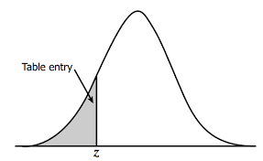
Personal epigenetic traits from WGBS
~ 300 CpGs per patient @ z-score >1.5, f<0.01
:
~ 500 CpGs per patient @ ASM P<0.001, f<0.01
~14 DMR pairs per patient (-2xlog10)
 | Mat | Pat
mC | 20 | 1
C | 2 | 17
Population MCC-seq cor matrix
WGBS correlated DMRs 30kb-3Mb (12K pairs)
Permutation
tests
Chr4:40814700 mCG
Chr5:176734500 mCG
Chr4:38564700 mCG
Chr5:175975200 mCG

Slide 30
Leverage functional data to define candidates for “negative genomes”
Using clustered z-score based prioritized gene search: 0-2 genes with high exomiser phenotype score are observed per patient
A->C
MGMT
z-score
z-score
z-score
Proband AC
Affected sib AC
Unaffected dad AC
Unaffected mom AA
Affected paternal aunt AC
Affected cousin AC
Affected cousin AC
Unrelated AA
Unrelated AA
z-score
z-score
z-score
z-score
z-score
z-score
PhastCons

Slide 31
Personal epivariants show strongest enrichment to local rare SNVs
All rare epivariants
Rare epivariants at blood regulatory elements
~25% of rare epivariants are within 2kb of rare SNV (gnomad<0.005)
- rare SNVs in proximity of rare epivariants have higher CADD scores and DHS overlap

Slide 32
Meta-analyses of mQTLs for GWAS
Step 1: Uniform methylation calling using Dragen (complete for all datasets)
Step 2: Imputation (not done uniformly for Bridget and EGEA) -> genotypes needed at McGill
Step 3: Whole blood/PBMC MCC-seq joint mQTL analyses (4 cohorts),(n= 2400)
Step 4: Validate (technical) against WB WGBS pop mapping (n=>500)
Step 5: Explore cell of origin (n=1600) fractionated blood MCC-qtl datasets (5 blood cell subsets)
Step 6: Apply universal GWAS coloc and annotate disease SNPs

Slide 33
Colocalisation pipeline, current WB mQTLs

Slide 34
Colocalisation pipeline, CD4 mQTLs

